Slide 1
CAPSTONE PROJECT
TICKET BOOKING IN BUS
Presented by:
KOWSALYA.U
2021309022
B.TECH TEXTILE TECHNOLOGY
ALAGAPPA COLLEGE OF TECHNOLOGY,ANNA UNIVERSITY

Slide 2
OUTLINE
Problem Statement
Proposed System/Solution
System Development Approach
Algorithm & Deployment
Result
Conclusion
Future Scope
References

Slide 3
PROBLEM STATEMENT
Outdated Technology: The system is built on outdated technology, making it slow and prone to frequent crashes and errors. This results in delays in processing bookings and frustrates both customers and staff.
2. Manual Processes: Much of the booking process is manual, requiring staff to input information manually and leading to a higher likelihood of errors. This not only causes delays in processing bookings but also results in incorrect reservations and double bookings. 3. Lack of Online Booking Options: The system does not offer online booking options, forcing customers to book tickets in person or over the phone. This limits convenience for customers and reduces the company's ability to reach a wider on audience.

Slide 4
4. Limited Seat Availability Information: The system does not provide real-time updates on seat availability, making it difficult for customers to know which seats are available at any given time. This can lead to confusion and frustration for customers trying to book tickets.
5. Inefficient Reservation Tracking: The system lacks robust features for tracking and managing reservations, making it challenging for staff to keep track of bookings, make changes, and handle cancellations effectively. This can result in overbooking, missed reservations, and dissatisfied

Slide 5
PROPOSED SOLUTION
1.One solution for outdated technology in ticket booking could be to invest in a modern, user-friendly online ticketing platform. This platform could offer features such as mobile ticketing, real-time availability updates, and personalized recommendations based on user preferences. Additionally, integrating the platform with popular payment methods and social media channels can enhance the overall customer experience. Regular updates and maintenance of the platform will ensure that it remains current and competitive in the market. Training staff on how to use the new technology effectively is also essential to ensure a smooth transition.

Slide 6
2.One solution to address the issue of limited seat availability information in ticket booking could be to implement a real-time seat availability feature on the online booking platform. This feature would provide customers with up-to-date information on the number of seats remaining for each event or show, allowing them to make informed decisions when booking their tickets. 3. To address the issue of inefficient reservation tracking in ticket booking, one solution could be to implement a robust reservation management system that streamlines the reservation process and ensures accurate tracking of reservations. 4. One solution to address the lack of online booking options in ticket booking could be to develop a user-friendly and secure online booking platform. This platform could allow customers to easily browse available tickets, select their desired seats or options, make secure payments, and receive instant confirmation of their booking.

Slide 7
5.One solution to address the issue of limited seat availability information in ticket booking could be to implement a real-time seat availability feature on the online booking platform. This feature would provide customers with up-to-date information on the number of seats remaining for each event or show, allowing them to make informed decisions when booking their tickets.

Slide 8
SYSTEM APPROACH
A system approach in ticket booking management involves viewing the ticket booking process as a complex system with interconnected components that work together to achieve a common goal. By adopting a holistic view of the system, organizations can identify interdependencies, optimize processes, and improve overall efficiency. Here is a detailed explanation of the system approach in ticket booking management:1. System Identification: - Identify the key components of the ticket booking system, including customers, booking channels (online, offline), payment processing, seat availability, customer support, and reporting. - Understand how these components interact with each other to facilitate the ticket booking process.2. System Analysis: - Analyze the current ticket booking system to identify bottlenecks, inefficiencies, and areas for improvement. - Consider factors such as customer demand patterns, peak booking times, payment processing delays, manual data entry errors, and customer feedback.3. System Design: - Design a new and improved ticket booking system that addresses the identified issues and aligns with the organization's goals. - Define the system requirements, functionalities, user interfaces, integrations with other systems, and data flows.

Slide 9
4. System Implementation: - Implement the new ticket booking system by upgrading technology, integrating new software solutions, and training staff on how to use the system effectively. - Ensure a smooth transition from the old system to the new system by conducting thorough testing, data migration, and user training.5. System Monitoring: - Monitor the performance of the new ticket booking system by tracking key metrics such as booking volume, conversion rates, customer satisfaction scores, and revenue generated. - Use monitoring tools and analytics to identify any issues or bottlenecks in real-time and take corrective actions promptly.6. System Optimization: - Continuously optimize the ticket booking system based on feedback from customers, staff, and performance metrics. - Implement improvements such as adding new features, streamlining processes, enhancing security measures, and integrating new technologies to enhance the system's efficiency and effectiveness.7. System Evaluation: - Evaluate the success of the new ticket booking system by comparing key performance indicators before and after implementation. - Gather feedback from customers and stakeholders to assess satisfaction levels and identify areas for further improvement.By adopting a system approach in ticket booking management, organizations can create a more efficient, customer-centric, and scalable system that enhances the overall booking experience for customers while driving business growth and profitability.

Slide 10
ALGORITHM & DEPLOYMENT
Step 1: Create a project name.
First open Pycharm IDE and then create a “project name” after creating a project name click the “create” button. Step 2: Create a python file.
Second after creating a project name, “right click” your project name and then click “new” after that click the “python file“.
Step 3: Name your python file.
Third after creating a python file, Name your python file after that click “enter“.
Step 4: The actual code.
You are free to copy the code given below and download the full source code below.

Slide 11
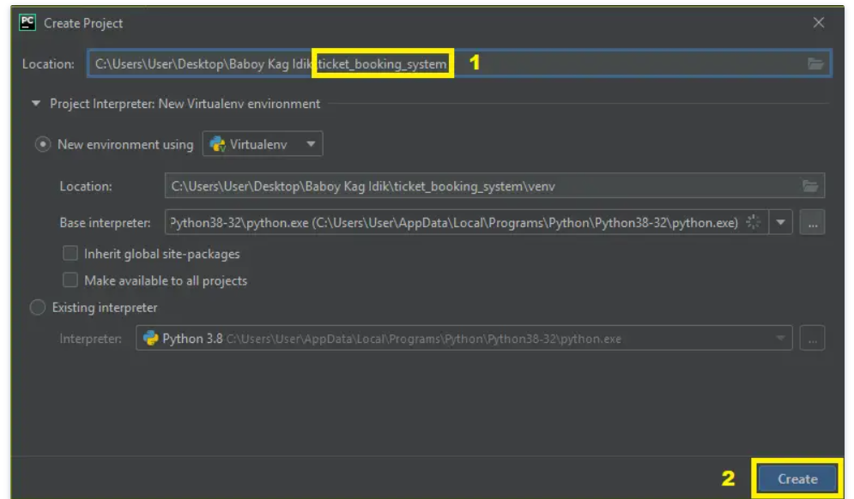
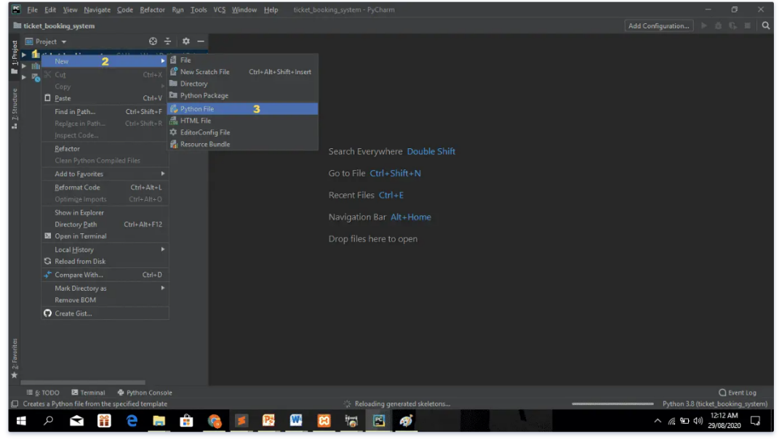
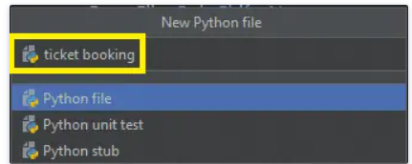
Step 1
Step 2
Step 3

Slide 12
RESULT
The results of effective ticket booking management can have a significant impact on various aspects of the business, customer experience, and overall success of an organization. Here are some key results that can be achieved through efficient ticket booking management:1. Increased Revenue Generation: - Optimized pricing strategies, dynamic pricing models, and targeted promotions can help maximize revenue by capturing demand fluctuations, offering personalized deals, and upselling additional services. - Efficient inventory management, yield optimization, and strategic partnerships can drive higher ticket sales and ancillary revenue streams.2. Enhanced Customer Satisfaction: - Seamless booking processes, personalized recommendations, and responsive customer service can improve customer satisfaction levels and loyalty. - User-friendly interfaces, convenient payment options, real-time updates, and personalized communication can enhance the overall booking experience and build long-term relationships with customers.3. Improved Operational Efficiency: - Automated ticket issuance, real-time inventory updates, streamlined processes, and integrated systems can increase operational efficiency and reduce manual errors. - Data-driven insights, predictive analytics, and demand forecasting tools can optimize resource allocation, inventory planning, and decision-making processes.4. Better Resource Utilization: - Efficient allocation of resources such as seating capacity, staff scheduling, equipment utilization, and infrastructure maintenance can optimize operational costs and improve profitability.

Slide 13
CONCLUSION
In conclusion, effective ticket booking management is a critical component of success for organizations in the travel, entertainment, sports, and event industries. By implementing best practices and leveraging technology solutions, businesses can achieve a wide range of benefits that positively impact their bottom line, customer satisfaction levels, operational efficiency, and overall competitiveness.

Slide 14
FUTURE SCOPE
1. Personalized Customer Experiences: - Personalization will be a key focus, with ticket booking platforms leveraging data analytics and AI to offer tailored recommendations, pricing, and promotions based on individual preferences and behavior. - Customized booking interfaces, personalized communication, and targeted offers will enhance customer engagement and loyalty.2. Omnichannel Booking Experiences: - Seamless integration across multiple channels such as websites, mobile apps, social media platforms, chatbots, and voice assistants will enable customers to book tickets conveniently across various touchpoints. - Unified customer profiles and consistent user experiences across channels will be crucial for delivering a cohesive omnichannel booking journey.3. Enhanced User Interface and Experience: - Intuitive interfaces, interactive seat maps, virtual tours, and immersive visualizations using AR/VR technologies will make the booking process more engaging and user-friendly. - Streamlined checkout processes, quick access to booking history, and personalized dashboards will improve overall user experience.4. Dynamic Pricing Strategies: - Dynamic pricing algorithms powered by machine learning will enable real-time adjustment of ticket prices based on demand, availability, market trends, and customer segmentation. - Personalized pricing models, targeted discounts, and dynamic bundling options will optimize revenue generation while maximizing customer value.

Slide 15
REFERENCES
Hangman game in python with source code
Aircarft war game in python with source code
Snake game in python code
How to make bouncing ball game in python with source codae

Slide 16
THANK YOU

